Slide 1
CYB 110 CYBERSECURITY AND PRIVACY MODULE 6 - COMPLIANCE JIM ALVES-FOSS AND JIA SONG

Slide 2
DEFENSE IN DEPTH
So far we talked about cybersecurity overarching concepts. Now we look at cybersecurity top-down/outside-in
Laws and Compliance
Operations Security
Human Elements of Security
Physical Security
Network Security
Operating System Security
Mobile, Embedded System, Internet of Things
Application Security
Assessing Security

Slide 3
COMPLIANCE
Compliance typically means satisfying the requirements of one or more laws, regulations or contracts.
Companies may have to be in compliance with more than one set of rules – chose the most strict for each category (e.g. time to keep logs)
Your business partners, auditors and compliance bodies have the ultimate say in whether you are “compliant” or not

Slide 4
TYPES OF COMPLIANCE
Regulatory Compliance
You adhere to laws specific to your industry
Federal Energy Regulatory Committee (FERC) following National American Electric Reliability Corporation (NERC) standards, FAA following RTCA standards, HHS following HIPAA, SEC following Sarbanes-Oxley
Cyclical audits are part of this process
Industry Standards
These are not laws, but may limit your ability to do business
Payment Card Industry (PCI) Data Security Standard (DSS)
Non Compliance
May lose privileges, licenses, or even criminal penalties

Slide 5
ACHIEVING COMPLIANCE WITH CONTROLS
Usually the laws/regulations discuss the types of “controls” you need
Physical Controls: Locks, fences, guards, cameras
Administrative Controls: What are the processes for accepting, avoiding or transferring risk. What are the processes for auditing and incident response?
Do you have an information security policy? When was it put in place?
Technical Controls: These include firewalls, intrusion detection systems, access controls, encryption, password scanners

Slide 6
KEY VERSUS COMPENSATING CONTROLS
Key Controls:
These are your primary controls
Provide a reasonable degree of assurance that risk is mitigated
If control fails, unlikely another control takes its place
Failure of this control will affect an entire process
Compensating Controls:
Used when other controls are impractical/infeasible. Need good reason.
Example: Regulation requires running antivirus on your machine, but machine too low powered. (i)Compensate by using an OS that is less susceptible to malware. (ii) Show how you limit user access to that machine/disable services.

Slide 7
MAINTAIN COMPLIANCE
Monitoring – You must monitor controls and data they produce
An intrusion detection system that creates alerts that are never seen is useless. (Or a door alarm that is silenced).
Reviewing – You must periodically review your controls
Are they up-to-date (software updates), crypto algorithm not broken, address modern threats.
Don’t get stuck in “analysis paralysis”. Review, improve and repeat

Slide 8
MAINTAIN COMPLIANCE (2)
Documenting: The dread of technologists.
Document results of review and changes made. Helps you evaluate trends and shows “continuous improvement”
Reporting: To leadership (and beyond)
Once you monitor, review and document, report to leadership. Report should follow a standard format.
This should be regularly scheduled; but can be an intermediate step if there is an urgent issue (new major vulnerability).
Leadership may include your documents to regulators/auditors.

Slide 9
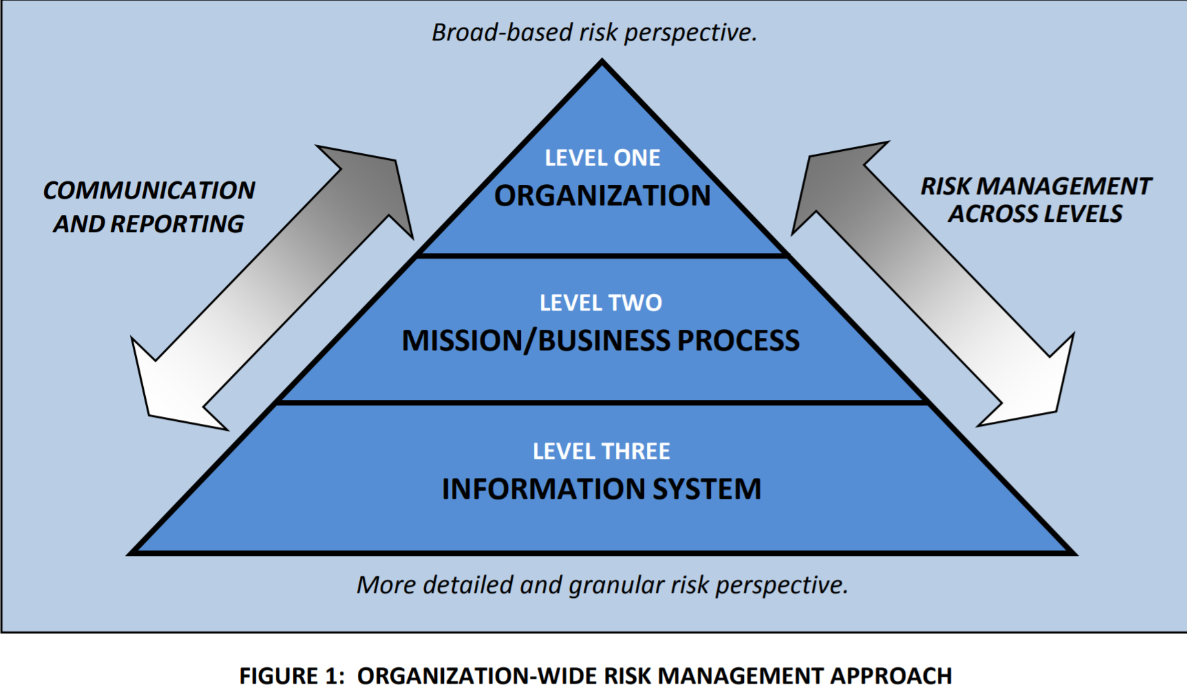
A DEEPER DIVE (NIST 800-37R2)

Slide 10
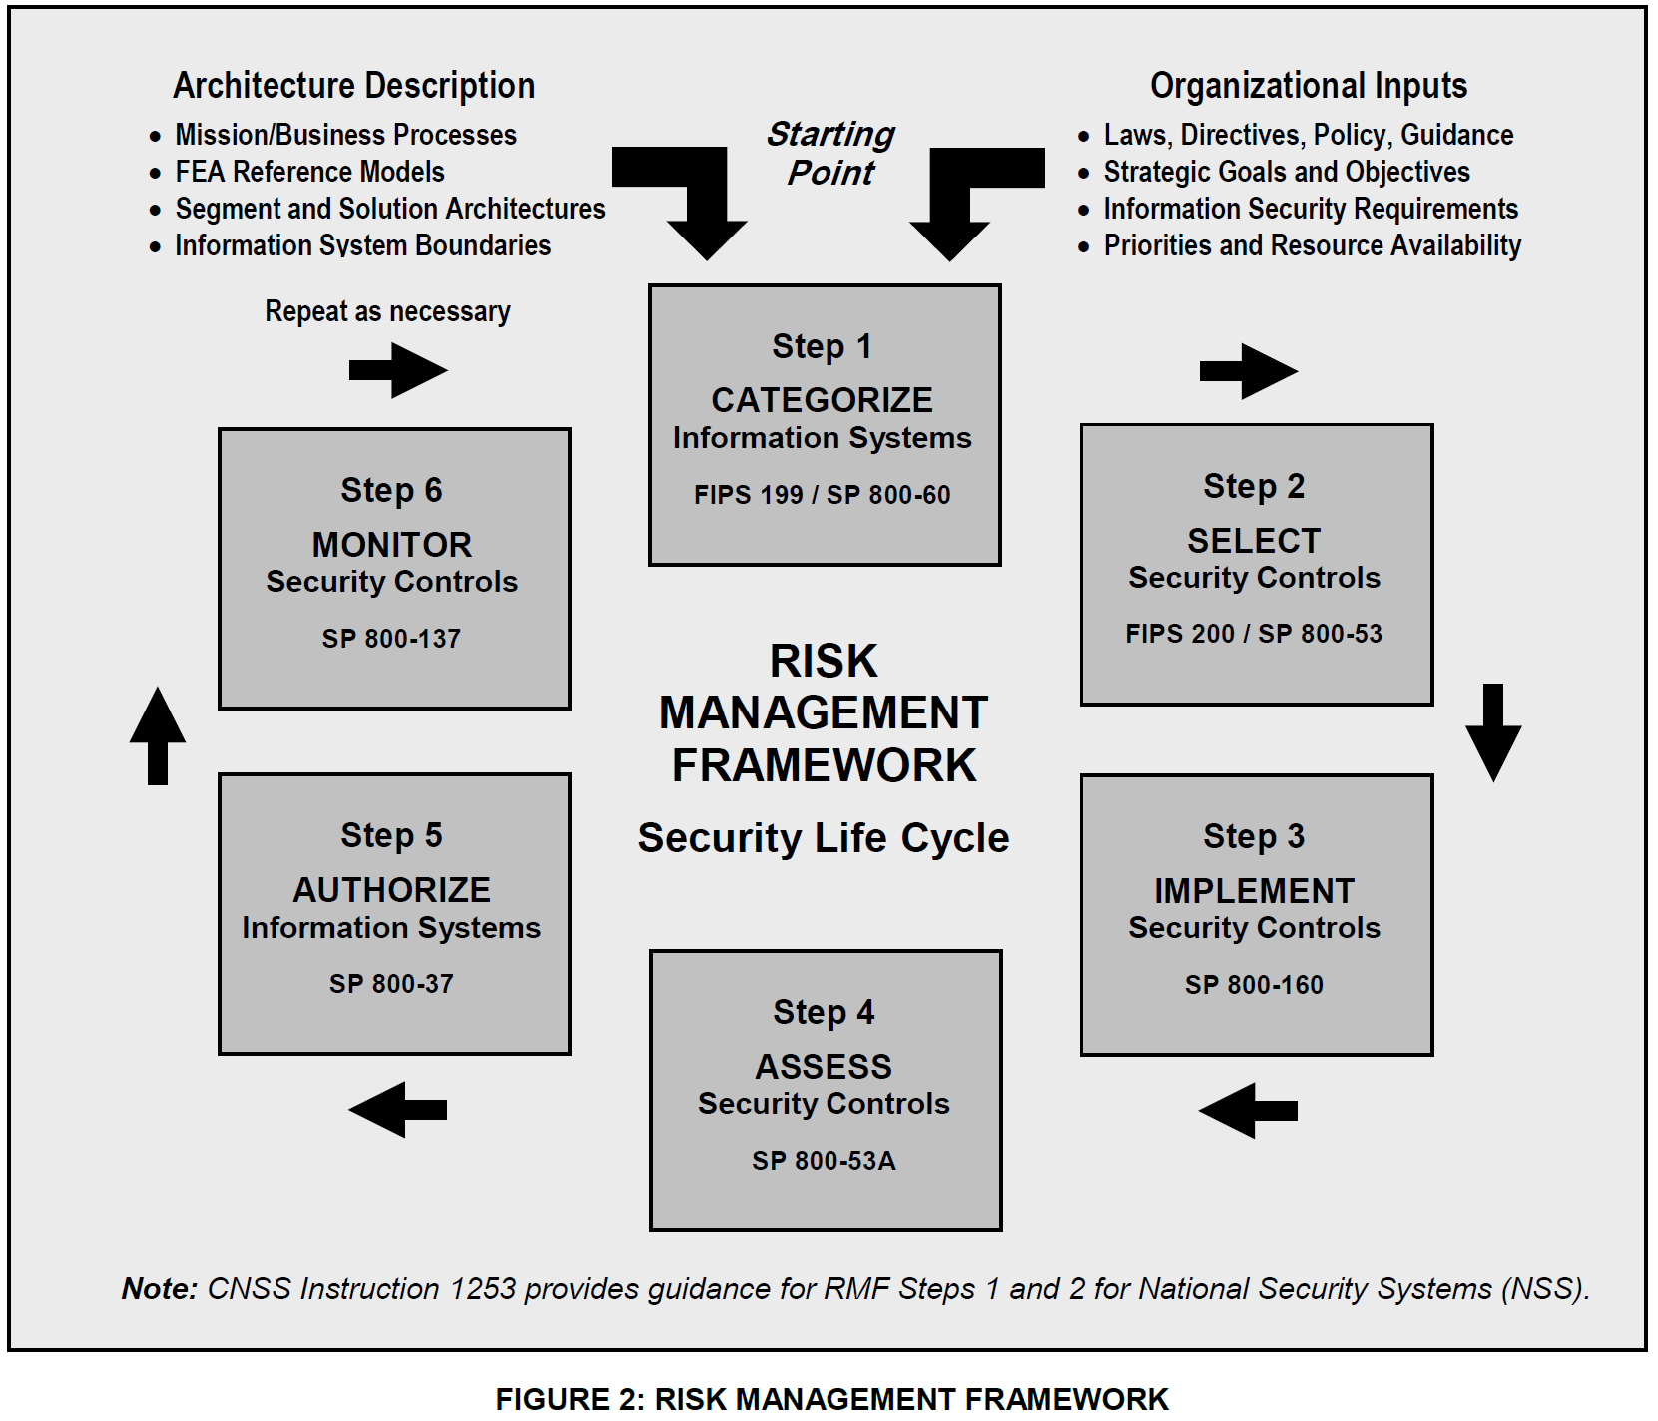

Slide 11
RISK MANAGEMENT FRAMEWORK
Step 1: Categorize the information system based on a FIPS Publication 199 impact assessment;
Step 2: Select the applicable security control baseline based on the results of the security categorization and apply tailoring guidance (including the potential use of overlays);
Step 3: Implement the security controls and document the design, development, and implementation details for the controls;

Slide 12
RISK MANAGEMENT FRAMEWORK (2)
Step 4: Assess the security controls to determine the extent to which the controls are implemented correctly, operating as intended, and producing the desired outcome with respect to meeting the security requirements for the system;²⁹
Step 5: Authorize information system operation based on a determination of risk to organizational operations and assets, individuals, other organizations, and the Nation resulting from the operation and use of the information system and the decision that this risk is acceptable; and
Step 6: Monitor the security controls in the information system and environment of operation on an ongoing basis to determine control effectiveness, changes to the system/environment, and compliance to legislation, Executive Orders, directives, policies, regulations, and standards.

Slide 13
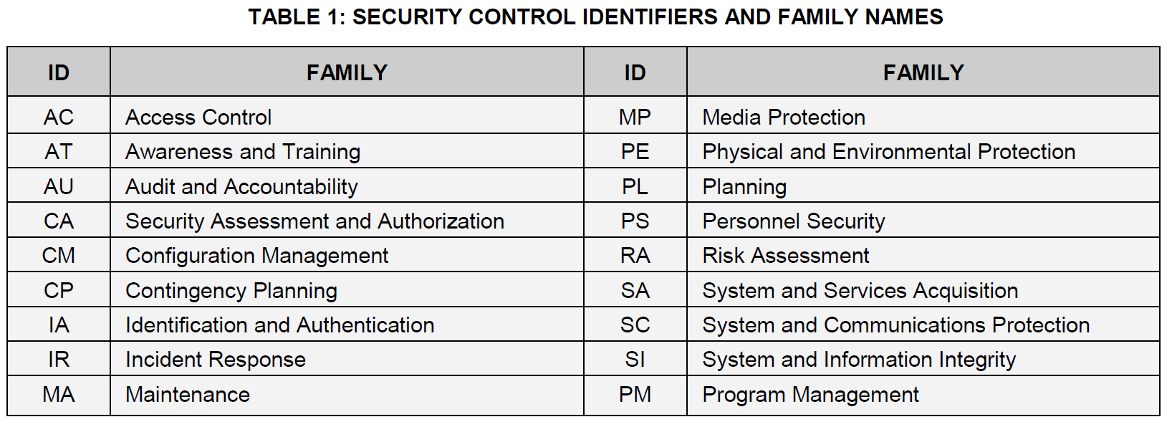
NIST 800-53R5 SECURITY CONTROLS

Slide 14
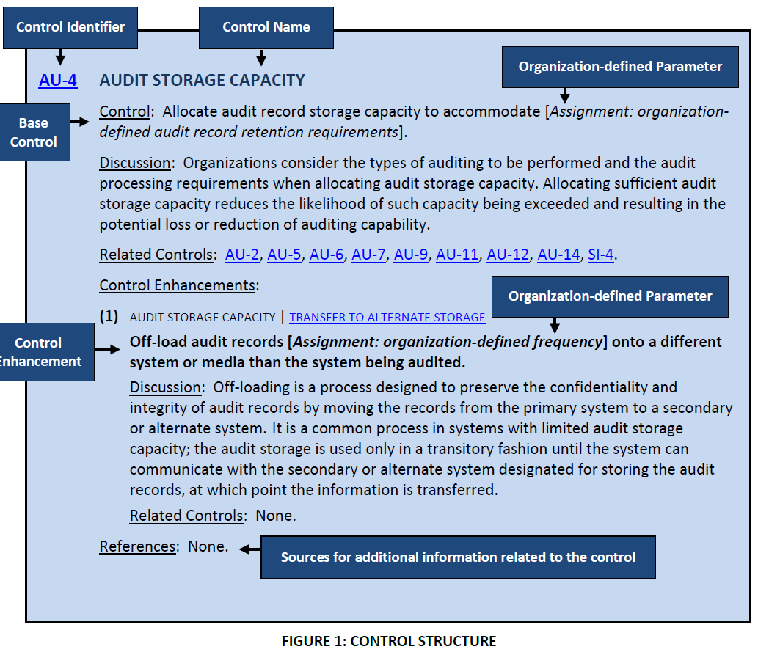

Slide 15
AC-7 UNSUCCESSFUL LOGON ATTEMPTS
From Chapter 3
Control:
Enforce a limit of [Assignment: organization-defined number] consecutive invalid logon attempts by a user during a [Assignment: organization-defined time period]; and
Automatically [Selection (one or more): lock the account or node for an [Assignment: organization-defined time period]; lock the account or node until released by an administrator; delay next logon prompt per [Assignment: organization-defined delay algorithm]; notify system administrator; take other [Assignment: organization-defined action]] when the maximum number of unsuccessful attempts is exceeded.

Slide 16
AC-7 UNSUCCESSFUL LOGON ATTEMPTS (2)
Discussion: The need to limit unsuccessful logon attempts and take subsequent action when the maximum number of attempts is exceeded applies regardless of whether the logon occurs via a local or network connection. Due to the potential for denial of service, automatic lockouts initiated by systems are usually temporary and automatically release after a predetermined, organization-defined time period. If a delay algorithm is selected, organizations may employ different algorithms for different components of the system based on the capabilities of those components. Responses to unsuccessful logon attempts may be implemented at the operating system and the application levels. Organization-defined actions that may be taken when the number of allowed consecutive invalid logon attempts is exceeded include prompting the user to answer a secret question in addition to the username and password, invoking a lockdown mode with limited user capabilities (instead of full lockout), allowing users to only logon from specified Internet Protocol (IP) addresses, requiring a CAPTCHA to prevent automated attacks, or applying user profiles such as location, time of day, IP address, device, or Media Access Control (MAC) address....

Slide 17
AC-7 UNSUCCESSFUL LOGON ATTEMPTS (3)
Control Enhancements:
UNSUCCESSFUL LOGON ATTEMPTS | AUTOMATIC ACCOUNT LOCK
[Withdrawn: Incorporated into AC-7.]
UNSUCCESSFUL LOGON ATTEMPTS | PURGE OR WIPE MOBILE DEVICE
Purge or wipe information from [Assignment: organization-defined mobile devices] based on [Assignment: organization-defined purging or wiping requirements and techniques] after [Assignment: organization-defined number] consecutive, unsuccessful device logon attempts.
...

Slide 18
AC-7 UNSUCCESSFUL LOGON ATTEMPTS (4)
Discussion: A mobile device is a computing device that has a small form factor such that it can be carried by a single individual; is designed to operate without a physical connection; possesses local, non-removable or removable data storage; and includes a self-contained power source. Purging or wiping the device applies only to mobile devices for which the organization-defined number of unsuccessful logons occurs. The logon is to the mobile device, not to any one account on the device. Successful logons to accounts on mobile devices reset the unsuccessful logon count to zero. Purging or wiping may be unnecessary if the information on the device is protected with sufficiently strong encryption mechanisms.
Related Controls: AC-19, MP-5, MP-6.

Slide 19
MORE CONTROLS
Review AC-1 and AC-2 from NIST 800-53.
Long list of concepts.

Slide 20
WHAT ARE SOME OF THE LAWS?
FISMA – Federal Information Security Management Act of 2014
FedRAMP – Federal Risk and Authorization Management Program
HIPAA – Health Insurance Portability and Accountability Act
SOX - Sarbanes-Oxley
GLBA – Gramm-Leach-Bliley Act
CIPA- Children’s Internet Protection Act
COPPA – Childrens Online Privacy Protection Act
FERPA – Family Educational Rights and Privacy Act
GDPR – General Data Protection Regulation

Slide 21
LEGAL AND ETHICAL ASPECTS
touch on a few topics including:
cybercrime and computer crime
intellectual property issues
privacy
ethical issues
Notes:
The legal and ethical aspects of computer security encompass a broad range of topics, and a full discussion is well beyond the scope of this book, however we touch on a few important topics in this area, including: cybercrime and computer crime; intellectual property issues; privacy and ethical issues.

Slide 22
CYBERCRIME / COMPUTER CRIME
“criminal activity in which computers or computer networks are a tool, a target, or a place of criminal activity”
categorize based on computer’s role:
as target
as storage device
as communications tool
used as the weapon
more comprehensive categorization seen in Cybercrime Convention, Computer Crime Surveys
Notes:
Computer crime, or cybercrime, is a term used broadly to describe criminal activity in which computers or computer networks are a tool, a target, or a place of criminal activity. These categories are not exclusive and many activities can be characterized as falling in one or more categories. The term cybercrime has a connotation of the use of networks specifically, whereas computer crime may or may not involve networks. The U.S. Department of Justice categorizes computer crime based on the role that the computer plays in the criminal activity, as follows:
• Computers as targets: to acquire information stored on that computer system, to control the target system without authorization or payment (theft of service), or to alter the integrity of data or interfere with the availability of the computer or server.
• Computers as storage devices: as a passive storage medium, e.g. for stolen password lists, credit card or calling card numbers, proprietary corporate information, pornographic image files, or "warez" (pirated commercial software).
• Computers as communications tools: often traditional crimes committed online. Examples include the illegal sale of prescription drugs, controlled substances, alcohol, and guns; fraud; gambling; and child pornography.
A more specific list of crimes is defined in the international Convention on Cybercrime and shown in Table 18.1, in the text. Yet another categorization is used in the CERT 2006 annual E-crime Survey, the results of which are shown in Table 23.2.

Slide 23
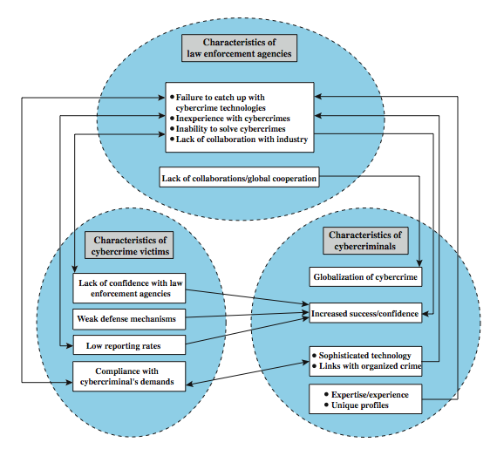
LAW ENFORCEMENT CHALLENGES
Notes:
The deterrent effect of law enforcement on computer and network attacks correlates with the success rate of criminal arrest and prosecution. The nature of cybercrime is such that consistent success is extraordinarily difficult. To see this, consider the vicious cycle of cybercrime, involving law enforcement agencies, cybercriminals, and cybercrime victims, as illustrated in Figure 23.1 from the text.
For law enforcement agencies, cybercrime presents some unique difficulties. Proper investigation requires a fairly sophisticated grasp of the technology, and many jurisdictions lack investigators knowledgeable and experienced in dealing with it. Lack of resources represents another handicap. The global nature of cybercrime is an additional obstacle: many crimes will involve perpetrators who are remote from the target system, in another jurisdiction or even another country. A lack of collaboration and cooperation with remote law enforcement agencies can greatly hinder an investigation. Initiatives such as international Convention on Cybercrime introduces a common terminology for crimes and a framework for harmonizing laws globally.
The relative lack of success in bringing cybercriminals to justice has led to an increase in their numbers, boldness, and the global scale of their operations. The cybercriminal tends to be young and very computer-savvy, but the range of behavioral characteristics is wide.
The success of cybercriminals, and the relative lack of success of law enforcement, influence the behavior of cybercrime victims. Reporting rates are low because of a lack of confidence in law enforcement, a concern about corporate reputation, and a concern about civil liability. The low reporting rates and reluctance to work with law enforcement feeds into the law enforcement handicaps, completing the vicious cycle.

Slide 24
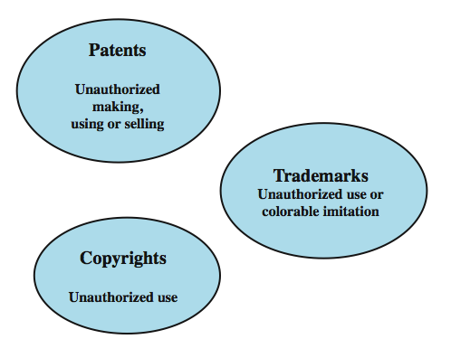
INTELLECTUAL PROPERTY
Notes:
The U.S. legal system, and legal systems generally, distinguish three primary types of property: real, personal and intellectual. Intellectual property is any intangible asset that consists of human knowledge and ideas. Examples include software, data, novels, sound recordings, the design of a new type of mousetrap, or a cure for a disease. There are three main types of intellectual property for which legal protection is available: copyrights, trademarks, and patents. The legal protection is against infringement, which is the invasion of the rights secured by, copyrights, trademarks, and patents. The right to seek civil recourse against anyone infringing his or her property is granted to the IP owner. Depending upon the type of IP, infringement may vary, as illustrated in Figure 23.2 from the text.

Slide 25
COPYRIGHT
protects tangible or fixed expression of an idea but not the idea itself
is automatically assigned when created
may need to be registered in some countries
exists when:
proposed work is original
creator has put original idea in concrete form
e.g. literary works, musical works, dramatic works, pantomimes and choreographic works, pictorial, graphic, and sculptural works, motion pictures and other audiovisual works, sound recordings, architectural works, software-related works.
Notes:
Copyright law protects the tangible or fixed expression of an idea, not the idea itself. Copyright is automatically assigned to newly created works in countries that subscribe to the Berne convention, which encompasses the vast majority of nations. Some countries, such as the United States, provide additional legal protection if the work is registered. Copyright exists if the following conditions are fulfilled:
• the proposed work is original
• the creator has put this original idea into a concrete form, such as hard copy (paper), software, or multimedia form
Examples of items that may be copyrighted include: literary works, musical works, dramatic works, pantomimes and choreographic works, pictorial, graphic, and sculptural works, motion pictures and other audiovisual works, sound recordings, architectural works, software-related works.

Slide 26
COPYRIGHT RIGHTS
copyright owner has these exclusive rights, protected against infringement:
reproduction right
modification right
distribution right
public-performance right
public-display right
Notes:
The copyright owner has the following exclusive rights, protected against infringement:
• Reproduction right: lets the owner make copies of a work.
• Modification right: also known as the derivative-works right, concerns modifying a work to create a new or derivative work.
• Distribution right: lets the owner publicly sell, rent, lease, or lend copies of the work.
• Public-performance right: applies mainly to live performances.
• Public-display right: lets the owner publicly show a copy of the work directly or by means of a film, slide, or television image.

Slide 27
PATENTS
grant a property right to the inventor
to exclude others from making, using, offering for sale, or selling the invention
types:
utility - any new and useful process, machine, article of manufacture, or composition of matter
design - new, original, and ornamental design for an article of manufacture
plant - discovers and asexually reproduces any distinct and new variety of plant
e.g. RSA public-key cryptosystem patent
Notes:
A patent for an invention is the grant of a property right to the inventor. The right conferred by the patent grant is, in the language of the U.S. statute and of the grant itself, "the right to exclude others from making, using, offering for sale, or selling" the invention in the United States or "importing" the invention into the United States. Similar wording appears in the statutes of other nations.
There are three types of patents:
• Utility patents: may be granted to anyone who invents or discovers any new and useful process, machine, article of manufacture, or composition of matter, or any new and useful improvement thereof;
• Design patents: may be granted to anyone who invents a new, original, and ornamental design for an article of manufacture; and
• Plant patents: may be granted to anyone who invents or discovers and asexually reproduces any distinct and new variety of plant.
An example of a patent from the computer security realm is the RSA public-key cryptosystem. From the time it was granted in 1983 until the patent expired in 2000, the patent holder, RSA Security, was entitled to receive a fee for each implementation of RSA.

Slide 28
TRADEMARKS
a word, name, symbol, or device
used in trade with goods
indicate source of goods
to distinguish them from goods of others
trademark rights may be used to:
prevent others from using a confusingly similar mark
but not to prevent others from making the same goods or from selling the same goods or services under a clearly different mark
Notes:
A trademark is a word, name, symbol, or device that is used in trade with goods to indicate the source of the goods and to distinguish them from the goods of others. A servicemark is the same as a trademark except that it identifies and distinguishes the source of a service rather than a product. The terms trademark and mark are commonly used to refer to both trademarks and servicemarks. Trademark rights may be used to prevent others from using a confusingly similar mark, but not to prevent others from making the same goods or from selling the same goods or services under a clearly different mark.

Slide 29
INTELLECTUAL PROPERTY ISSUES AND COMPUTER SECURITY
software programs
protect using copyright, perhaps patent
database content and arrangement
protect using copyright
digital content audio / video / media / web
protect using copyright
algorithms
may be able to protect by patenting
Notes:
Intellectual Property Relevant to Network and Computer Security include:
• Software: This includes programs produced by vendors of commercial software (e.g., operating systems, utility programs, applications) as well as shareware, proprietary software created by an organization for internal use, and software produced by individuals. For all such software, copyright protection is available if desired. In some cases, a patent protection may also be appropriate.
• Databases: A database may consist of data that is collected and organized in such a fashion that it has potential commercial value. An example is an economic forecasting database. Such databases may be protected by copyright.
• Digital content: This category includes audio files, video files, multimedia, courseware, Web site content, and any other original digital work that can be presented in some fashion using computers or other digital devices.
• Algorithms: An example of a patentable algorithm, previously cited, is the RSA public-key cryptosystem.

Slide 30
U.S. DIGITAL MILLENNIUM COPYRIGHT ACT (DMCA 1998)
implements WIPO treaties to strengthens protections of digital copyrighted materials
encourages copyright owners to use technological measures to protect their copyrighted works, including:
measures that prevent access to the work
measures that prevent copying of the work
prohibits attempts to bypass the measures
have both criminal and civil penalties for this
Notes:
The U.S. Digital Millennium Copyright ACT (DMCA) has had a profound effect on the protection of digital content rights in both the U.S. and worldwide. The DMCA, signed into law in 1998, is designed to implement World Intellectual Property Organization (WIPO) treaties, signed in 1996. In essence, DMCA strengthens the protection of copyrighted materials in digital format.
The DMCA encourages copyright owners to use technological measures to protect copyrighted works. These measures fall into two categories: measures that prevent access to the work and measures that prevent copying of the work. Further, the law prohibits attempts to bypass such measures. Specifically, the law states that "No person shall circumvent a technological measure that effectively controls access to a work protected under this title." Among other effects of this clause, it prohibits almost all unauthorized decryption of content. The law further prohibits the manufacture, release, or sale of products, services, and devices that can crack encryption designed to thwart either access to or copying of material unauthorized by the copyright holder. Both criminal and civil penalties apply to attempts to circumvent technological measures and to assist in such circumvention.

Slide 31
DMCA EXEMPTIONS
certain actions are exempted from the DMCA provisions:
fair use
reverse engineering
encryption research
security testing
personal privacy
considerable concern exists that DMCA inhibits legitimate security/crypto research
Notes:
Certain actions are exempted from the provisions of the DMCA and other copyright laws, including the following:
• Fair use: This concept is not tightly defined. It is intended to permit others to perform, show, quote, copy, and otherwise distribute portions of the work for certain purposes, including review, comment, and discussion of copyrighted works.
• Reverse engineering: of a software product is allowed if the user has the right to use a copy of the program and if the purpose of the reverse engineering is not to duplicate the functionality of the program but rather to achieve interoperability.
• Encryption research: "Good faith" encryption research is allowed. This exemption allows decryption attempts to advance the development of encryption technology.
• Security testing: is the access of a computer or network for the good faith testing, investigating, or correcting a security flaw or vulnerability, with the authorization of the owner or operator.
• Personal privacy: is generally permitted to bypass technological measures if that is the only reasonable way to prevent the access to result in the revealing or recording of personally identifying information.
Despite the exemptions built into the act, there is considerable concern, especially in the research and academic communities, that the act inhibits legitimate security and encryption research. These parties feel that DMCA stifles innovation and academic freedom and is a threat to open source software development

Slide 32
DIGITAL RIGHTS MANAGEMENT (DRM)
systems and procedures ensuring digital rights holders are clearly identified and receive stipulated payment for their works
may impose further restrictions on their use
no single DRM standard or architecture
goal often to provide mechanisms for the complete content management lifecycle
provide persistent content protection for a variety of digital content types / platforms / media
Notes:
Digital Rights Management (DRM) refers to systems and procedures that ensure that holders of digital rights are clearly identified and receive the stipulated payment for their works. The systems and procedures may also impose further restrictions on the use of digital objects, such as inhibiting printing or prohibiting further distribution.
There is no single DRM standard or architecture. DRM encompasses a variety of approaches to intellectual property management and enforcement by providing secure and trusted automated services to control the distribution and use of content. In general, the objective is to provide mechanisms for the complete content management lifecycle (creation, subsequent contribution by others, access, distribution, use), including the management of rights information associated with the content.
DRM systems should meet the following objectives:
1. Provide persistent content protection against unauthorized access to the digital content, limiting access to only those with the proper authorization.
2. Support a variety of digital content types (e.g., music files, video streams, digital books, images).
3. Support content use on a variety of platforms, (e.g., PCs, PDAs, iPods, mobile phones).
4. Support content distribution on a variety of media, including CD-ROMs, DVDs, and flash memory.

Slide 33
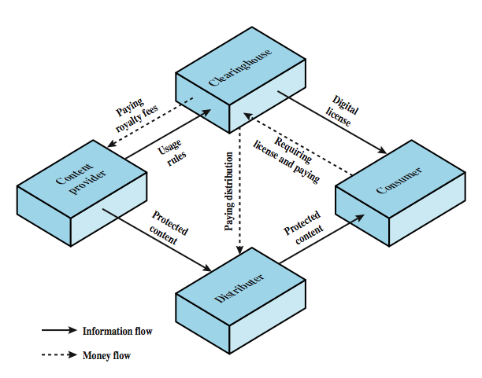
DRM COMPONENTS
Notes:
Figure 23.3 from the text, illustrates a typical DRM model in terms of the principal users of DRM systems. These are:
• Content provider: Holds the digital rights of the content and wants to protect these rights. Examples are a music record label and a movie studio.
• Distributor: provides distribution channels, such as an online shop or a Web retailer. e.g. an online distributor receives digital content from the content provider and creates a Web catalogue presenting the content and rights metadata for its promotion.
• Consumer: Uses the system to access the digital content by retrieving downloadable or streaming content through the distribution channel and then paying for the digital license. The player/viewer application used by the consumer takes charge of initiating license request to the clearinghouse and enforcing the content usage rights.
• Clearinghouse: Handles the financial transaction for issuing the digital license to the consumer and pays royalty fees to the content provider and distribution fees to the distributor accordingly. The clearinghouse is also responsible for logging license consumptions for every consumer.
In this model, the distributor need not enforce the access rights. Instead, the content provider protects the content in such a way (typically encryption) that the consumer must purchase a digital license and access capability from the clearinghouse. The clearinghouse consults usage rules provided by the content provider to determine what access is permitted and the fee for a particular type of access. Having collected the fee, the clearinghouse credits the content provider and distributor appropriately.

Slide 34
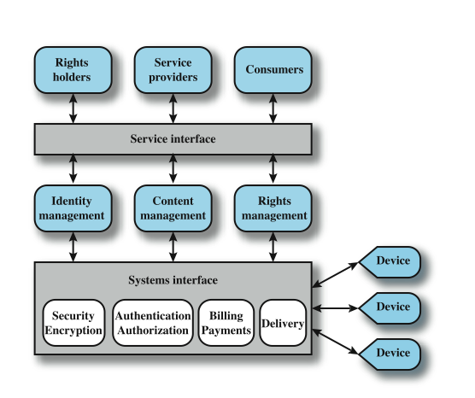
DRM SYSTEM ARCHITECTURE
Notes:
Figure 23.4 shows a generic system architecture to support DRM functionality.
The system is access by parties in three roles. Rights holders are the content providers, who either created the content or have acquired rights to the content. Service providers include distributors and clearinghouses. Consumers are those who purchase the right to access to content for specific uses.
There is system interface to the services provided by the DRM system:
• Identity management: mechanisms for unique entities, such as parties and content.
• Content management: processes and functions to manage the content lifecycle.
• Rights management: processes and functions needed to manage rights, rights holders, and associated requirements.
Below these management modules are common functions. The security/encryption module provides functions to encrypt content and to sign license agreements. The identity management service makes use of the authentication and authorization functions to identify all parties in the relationship. Using these functions, the identity management service includes the following: Allocation of unique party identifiers, User profile and preferences, User's device management, Public key management.
Billing/payments functions deal with the collection of usage fees from consumers and the distribution of payments to rights holders and distributors. Delivery functions deal with the delivery of content to consumers.

Slide 35
SARBANES OXLEY (2002)
To protect investors by improving the accuracy and reliability of corporate disclosures made pursuant to the security laws, and for other purposes.
Section 302
Section 302 states that the Chief Executive Officer (CEO) and Chief Financial Officer (CFO) must personally certify that financial reports are accurate and complete. They must also assess and report on the effectiveness of internal controls around financial reporting. This section clearly places responsibility for accurate financial reporting on the highest level of corporate management. CEOs and CFOs now face the potential for criminal fraud liability. It is noteworthy that section 302 does not specifically list which internal controls must be assessed.

Slide 36
MORE SARBANES OXLEY
Section 404
Section 404 states that a corporation must assess the effectiveness of its internal controls and report this assessment annually to the SEC. The assessment must also be reviewed and judged by an outside auditing firm. The impact of section 404 is substantial in that a large amount of resources are needed for compliance. A comprehensive review of all internal controls related to financial reporting is a daunting task. As with section 302, the wording of section 404 is broad and does not provide specific guidance as to which controls must be assessed.

Slide 37
PRIVACY
overlaps with computer security
have dramatic increase in scale of info collected and stored
motivated by law enforcement, national security, economic incentives
but individuals increasingly aware of access and use of personal / private info
concerns on extent of privacy compromise have seen a range of responses
Notes:
An issue with considerable overlap with computer security is that of privacy. On the one hand, the scale and interconnectedness of personal information collected and stored in information systems has increased dramatically, motivated by law enforcement, national security, and economic incentives. The last mentioned has been perhaps the main driving force. In a global information economy, it is likely that the most economically valuable electronic asset is aggregations of information on individual. On the other hand, individuals have become increasingly aware of the extent to which government agencies, businesses, and even Internet users have access to their personal information and private details about their lives and activities. Concerns about the extent to which personal privacy has been and may be compromised have led to a variety of legal and technical approaches to reinforcing privacy rights.

Slide 38
EU PRIVACY LAW
European Union Data Protection Directive was adopted in 1998 to:
ensure member states protect fundamental privacy rights when processing personal info
prevent member states from restricting the free flow of personal info within EU
organized around principles of:
notice, consent, consistency, access, security, onward transfer, enforcement
Updated as General Data Protection Regulation (GDPR) 2018
Notes:
A number of international organizations and national governments have introduced laws and regulations intended to protect individual privacy.
European Union Data Protection Directive was adopted in 1998, to both (1) ensure that member states protected fundamental privacy rights when processing personal information, and (2) prevent member states from restricting the free flow of personal information within the EU. The Directive is organized around the following principles of personal information use:
• Notice: organizations must notify individuals what personal information they are collecting, the uses of that information, and what choices the individual may have.
• Consent: individuals must be able to choose whether and how their personal information is used by, or disclosed to, third parties. They have the right not to have any sensitive information collected or used without express permission, including race, religion, health, union membership, beliefs, and sex life.
• Consistency: organizations may use personal information only in accordance with the terms of the notice given the data subject and the choices the make on its use
• Access: individuals must have the right and ability to access their information and correct, modify, or delete any portion of it.
• Security: organizations must provide adequate security, using technical and other means, to protect the integrity and confidentiality of personal information.
• Onward transfer: third parties receiving personal information must provide the same level of privacy protection as the organization from whom the information is obtained.
• Enforcement: grants a private right of action to data subjects when organizations do not follow the law.

Slide 39
GENERAL DATA PROTECTION REGULATION (GDPR) 2018
(From Here)
First, if you process the personal data of EU citizens or residents, or you offer goods or services to such people, then the GDPR applies to you even if you’re not in the EU. Details in another article.
Second, the fines for violating the GDPR are very high. There are two tiers of penalties, which max out at €20 million or 4% of global revenue (whichever is higher), plus data subjects have the right to seek compensation for damages.

Slide 40
GDPR DEFINITIONS
Personal data — Personal data is any information that relates to an individual who can be directly or indirectly identified. Names and email addresses are obviously personal data. Location information, ethnicity, gender, biometric data, religious beliefs, web cookies, and political opinions can also be personal data. Pseudonymous data can also fall under the definition if it’s relatively easy to ID someone from it.
Data processing — Any action performed on data, whether automated or manual. The examples cited in the text include collecting, recording, organizing, structuring, storing, using, erasing… so basically anything.
Data subject — The person whose data is processed. These are your customers or site visitors.

Slide 41
GDPR DEFINITIONS (2)
Data controller — The person who decides why and how personal data will be processed. If you’re an owner or employee in your organization who handles data, this is you.
Data processor — A third party that processes personal data on behalf of a data controller. The GDPR has special rules for these individuals and organizations. They could include cloud servers like Tresorit or email service providers like ProtonMail, GMAIL, etc

Slide 42
DATA PROTECTION PRINCIPLES
If you process data, you have to do so according to seven protection and accountability principles outlined in Article 5.1-2:
Lawfulness, fairness and transparency — Processing must be lawful, fair, and transparent to the data subject.
Purpose limitation — You must process data for the legitimate purposes specified explicitly to the data subject when you collected it.
Data minimization — You should collect and process only as much data as absolutely necessary for the purposes specified.
Accuracy — You must keep personal data accurate and up to date.
Storage limitation — You may only store personally identifying data for as long as necessary for the specified purpose.
Integrity and confidentiality — Processing must be done in such a way as to ensure appropriate security, integrity, and confidentiality (e.g. by using encryption).
Accountability — The data controller is responsible for being able to demonstrate GDPR compliance with all of these principles.

Slide 43
ACCOUNTABILITY
The GDPR says data controllers have to be able to demonstrate they are GDPR compliant. And this isn’t something you can do after the fact: If you think you are compliant with the GDPR but can’t show how, then you’re not GDPR compliant. Among the ways you can do this:
Designate data protection responsibilities to your team.
Maintain detailed documentation of the data you’re collecting, how it’s used, where it’s stored, which employee is responsible for it, etc.
Train your staff and implement technical and organizational security measures.
Have Data Processing Agreement contracts in place with third parties you contract to process data for you.
Appoint a Data Protection Officer (though not all organizations need one — more on that in this article).

Slide 44
DATA SECURITY
You’re required to handle data securely by implementing “appropriate technical and organizational measures.”
Technical measures mean anything from requiring your employees to use two-factor authentication on accounts where personal data are stored to contracting with cloud providers that use end-to-end encryption.
Organizational measures are things like staff trainings, adding a data privacy policy to your employee handbook, or limiting access to personal data to only those employees in your organization who need it.
If you have a data breach, you have 72 hours to tell the data subjects or face penalties. (This notification requirement may be waived if you use technological safeguards, such as encryption, to render data useless to an attacker.)

Slide 45
DATA PROTECTION BY DESIGN AND BY DEFAULT
From now on, everything you do in your organization must, “by design and by default,” consider data protection. Practically speaking, this means you must consider the data protection principles in the design of any new product or activity. The GDPR covers this principle in Article 25.
Suppose, for example, you’re launching a new app for your company. You have to think about what personal data the app could possibly collect from users, then consider ways to minimize the amount of data and how you will secure it with the latest technology.

Slide 46
WHEN YOU’RE ALLOWED TO PROCESS DATA
Article 6 lists the instances in which it’s legal to process personal data. Don’t even think about touching somebody’s personal data — don’t collect it, don’t store it, don’t sell it to advertisers — unless you can justify it with one of the following:
The data subject gave you specific, unambiguous consent to process the data. (e.g. They’ve opted in to your marketing email list.)
Processing is necessary to execute or to prepare to enter into a contract to which the data subject is a party. (e.g. You need to do a background check before leasing property to a prospective tenant.)
You need to process it to comply with a legal obligation of yours. (e.g. You receive an order from the court in your jurisdiction.)

Slide 47
WHEN YOU’RE ALLOWED TO PROCESS DATA (2)
You need to process the data to save somebody’s life. (e.g. Well, you’ll probably know when this one applies.)
Processing is necessary to perform a task in the public interest or to carry out some official function. (e.g. You’re a private garbage collection company.)
You have a legitimate interest to process someone’s personal data. This is the most flexible lawful basis, though the “fundamental rights and freedoms of the data subject” always override your interests, especially if it’s a child’s data. (It’s difficult to give an example here because there are a variety of factors you’ll need to consider for your case. The UK Information Commissioner’s Office provides helpful guidance here.)

Slide 48
WHEN YOU’RE ALLOWED TO PROCESS DATA (3)
Once you’ve determined the lawful basis for your data processing, you need to document this basis and notify the data subject (transparency!). And if you decide later to change your justification, you need to have a good reason, document this reason, and notify the data subject.

Slide 49
CONSENT
There are strict rules about what constitutes consent from a data subject to process their information.
Consent must be “freely given, specific, informed and unambiguous.”
Requests for consent must be “clearly distinguishable from the other matters” and presented in “clear and plain language.”
Data subjects can withdraw previously given consent whenever they want, and you have to honor their decision. You can’t simply change the legal basis of the processing to one of the other justifications.
Children under 13 can only give consent with permission from their parent.
You need to keep documentary evidence of consent.

Slide 50
DATA PROTECTION OFFICERS
Contrary to popular belief, not every data controller or processor needs to appoint a Data Protection Officer (DPO). There are three conditions under which you are required to appoint a DPO:
You are a public authority other than a court acting in a judicial capacity.
Your core activities require you to monitor people systematically and regularly on a large scale. (e.g. You’re Google.)
Your core activities are large-scale processing of special categories of data listed under Article 9 of the GDPR or data relating to criminal convictions and offenses mentioned in Article 10. (e.g. You’re a medical office.)

Slide 51
PEOPLE’S PRIVACY RIGHTS
You are a data controller and/or a data processor. But as a person who uses the Internet, you’re also a data subject. The GDPR recognizes a litany of new privacy rights for data subjects, which aim to give individuals more control over the data they loan to organizations. As an organization, it’s important to understand these rights to ensure you are GDPR compliant.

Slide 52
PEOPLE’S PRIVACY RIGHTS (2)
Below is a rundown of data subjects’ privacy rights:
The right to be informed
The right of access
The right to rectification
The right to erasure
The right to restrict processing
The right to data portability
The right to object
Rights in relation to automated decision making and profiling.

Slide 53
US PRIVACY LAW
have Privacy Act of 1974 which:
permits individuals to determine records kept
permits individuals to forbid records being used for other purposes
permits individuals to obtain access to records
ensures agencies properly collect, maintain, and use personal info
creates a private right of action for individuals
also have a range of other privacy laws
Notes:
The first comprehensive privacy legislation adopted in the United States was the Privacy Act of 1974, which dealt with personal information collected and used by federal agencies. The act is intended to:
1. Permit individuals to determine what records pertaining to them are collected, maintained, used, or disseminated.
2. Permit individuals to forbid records obtained for one purpose to be used for another purpose without consent.
3. Permit individuals to obtain access to records pertaining to them and to correct and amend such records as appropriate.
4. Ensure that agencies collect, maintain, and use personal information in a manner that ensures that the information is current, adequate, relevant, and not excessive for its intended use.
5. Create a private right of action for individuals whose personal information is not used in accordance with the act.
As with all privacy laws and regulations, there are exceptions and conditions attached to this act, such as criminal investigations, national security concerns, and conflicts between competing individual rights of privacy.
While the 1974 Privacy Act covers government records, a number of other U.S. laws have been enacted that cover other areas, including: Banking and financial records, Credit , Medical and health insurance records, Children's privacy, Electronic communications.

Slide 54
ORGANIZATIONAL RESPONSE
“An organizational data protection and privacy policy should be developed and implemented. This policy should be communicated to all persons involved in the processing of personal information. Compliance with this policy and all relevant data protection legislation and regulations requires appropriate management structure and control. Often this is best achieved by the appointment of a person responsible, such as a data protection officer, who should provide guidance to managers, users, and service providers on their individual responsibilities and the specific procedures that should be followed. Responsibility for handling personal information and ensuring awareness of the data protection principles should be dealt with in accordance with relevant legislation and regulations. Appropriate technical and organizational measures to protect personal information should be implemented.”
Notes:
Organizations need to deploy both management controls and technical measures to comply with laws and regulations concerning privacy as well as to implement corporate policies concerning employee privacy. ISO 17799 (Code of Practice for Information Security Management) states the requirement as follows:
ISO 17799: Data protection and privacy of personal information
An organizational data protection and privacy policy should be developed and implemented. This policy should be communicated to all persons involved in the processing of personal information. Compliance with this policy and all relevant data protection legislation and regulations requires appropriate management structure and control. Often this is best achieved by the appointment of a person responsible, such as a data protection officer, who should provide guidance to managers, users, and service providers on their individual responsibilities and the specific procedures that should be followed. Responsibility for handling personal information and ensuring awareness of the data protection principles should be dealt with in accordance with relevant legislation and regulations. Appropriate technical and organizational measures to protect personal information should be implemented.

Slide 55
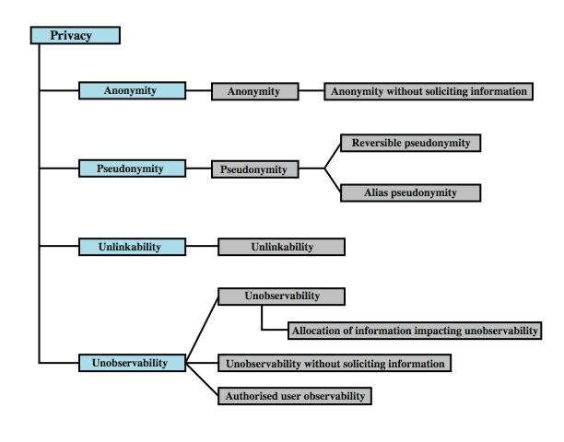
COMMON CRITERIA PRIVACY CLASS
Notes:
The Common Criteria specification includes a definition of a set of functional requirements in a Privacy Class, which should be implemented in a trusted system. The purpose of the privacy functions is to provide a user protection against discovery and misuse of identity by other users. It is primarily concerned with the privacy of an individual with respect to their use of computer resources, rather than the privacy of their personal information. This specification is a useful guide to how to design privacy support functions as part of a computer system.
Figure 23.5 shows a breakdown of privacy into four major areas:
• Anonymity: Ensures that a user may use a resource or service without disclosing the user’s identity. Specifically, this means that other users or subjects are unable to determine the identity of a user bound to a subject (e.g., process or user group) or operation. It further means that the system will not solicit the real name of a user. Anonymity need not conflict with authorization and access control functions, which are bound to computer-based user IDs, not to personal user information.
• Pseudonymity: ensures that a user may use a resource or service without disclosing its user identity, but can still be accountable for that use. The system shall provide an alias to prevent other users from determining a user's identity but the system shall be able to determine the user's identity from an assigned alias.
• Unlinkability: ensures that a user may make multiple uses of resources or services without others being able to link these uses together.
• Unobservability: ensures that a user may use a resource or service without others, especially third parties, being able to observe that the resource or service is being used.

Slide 56
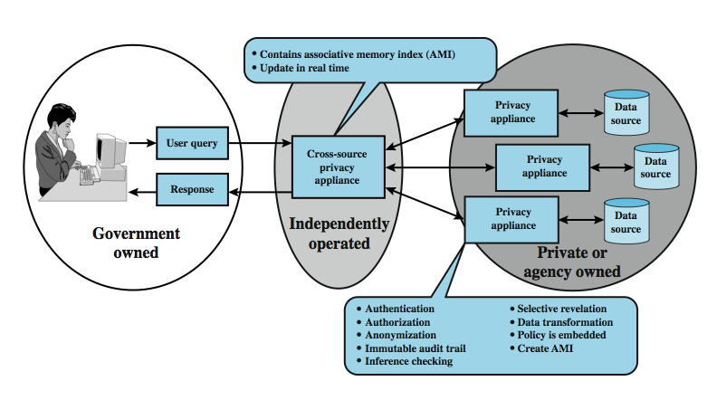
PRIVACY AND DATA SURVEILLANCE
Notes:
The demands of homeland security and counterterrorism have imposed new threats to personal privacy. Law enforcement and intelligence agencies have become increasingly aggressive in using data surveillance techniques. Also, private organizations are increasing their ability to build detailed profiles of individuals. Both policy and technical approaches are needed to protect privacy when both government and non-government organizations seek to learn as much as possible about individuals. In terms of technical approaches, the requirements for privacy protection for information systems can be addressed in the context of database security.
Figure 23.6 shows a privacy appliance, which is a tamper-resistant, cryptographically protected device that is interposed between a database and the access interface. It implements privacy protection functions, including verifying the user's access permissions / credentials and creating an audit log. Some of its specific functions are:
• Data transformation: encodes or encrypts portions of the data so as to preserver privacy but still allow data analysis functions needed for effective use.
• Anonymization: removes specific identifying information from query results, replacing themwith an anonymized unique identifier
• Selective revelation: a method for minimizing exposure of individual information while enabling continuous analysis of potentially interconnected data.
• Immutable audit: a method that identifies where data goes and who has seen it.
• Associative memory: a software module that recognizes patterns / connections between pieces of data that the human user may have missed or didn’t know existed.

Slide 57
ETHICAL ISSUES
have many potential misuses / abuses of information and electronic communication that create privacy and security problems
ethics:
a system of moral principles relating benefits and harms of particular actions to rightness and wrongness of motives and ends of them
ethical behavior here not unique
but do have some unique considerations
in scale of activities, in new types of entities
Notes:
Because of the ubiquity and importance of information systems in organization of all types, there are many potential misuses and abuses of information and electronic communication that create privacy and security problems. In addition to questions of legality, misuse and abuse raise concerns of ethics. Ethics refers to a system of moral principles that relates to the benefits and harms of particular actions, and to the rightness and wrongness of motives and ends of those actions.
To a certain extent, a characterization of what constitutes ethical behavior for those who work with or have access to information systems is not unique to this context. The basic ethical principles developed by civilizations apply. However, there are some unique considerations surrounding computers and information systems. Firstly, computer technology makes possible a scale of activities not possible before. This includes a larger scale of record keeping, particularly on individuals with the ability to develop finer-grained personal information collection and more precise data mining and data matching. The expanded scale of communications and the expanded scale of interconnection brought about by the Internet magnify the power of an individual to do harm. Secondly, computer technology has involved the creation of new types of entities for which no agreed ethical rules have previously been formed, such as databases, Web browsers, chat rooms, cookies, and so on.

Slide 58
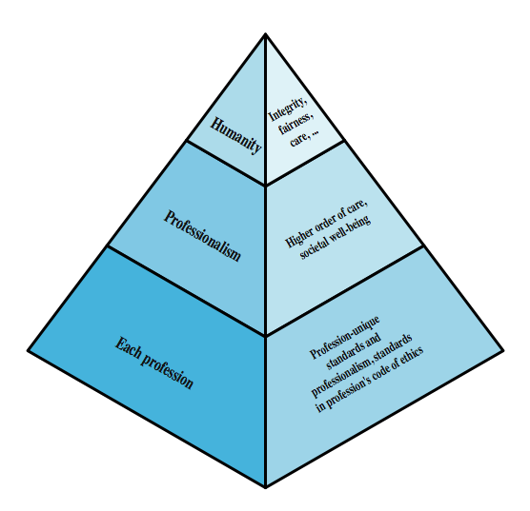
ETHICAL HIERARCHY
Notes:
It has always been the case that those with special knowledge or special skills have additional ethical obligations beyond those common to all humanity. We can illustrate this in terms of an ethical hierarchy , as illustrated in Figure 23.7 from the text. At the top of the hierarchy are the ethical values professionals share with all human beings, such as integrity, fairness, and justice. Being a professional with special training imposes additional ethical obligations with respect to those affected by his or her work. General principles applicable to all professionals arise at this level. Finally, each profession has associated with it specific ethical values and obligations related to the specific knowledge of those in the profession and the powers that they have to affect others. Most professions embody all of these levels in a professional code of conduct, a subject discussed subsequently.

Slide 59
ETHICAL ISSUES RELATED TO COMPUTERS AND INFO SYSTEMS
some ethical issues from computer use:
repositories and processors of information
producers of new forms and types of assets
instruments of acts
symbols of intimidation and deception
those who understand / exploit technology, and have access permission, have power over these
issue is balancing professional responsibilities with ethical or moral responsibilities
Notes:
Now consider some ethical issues that arise from computer technology. A classic paper on computers and ethics points out that ethical issues arise as the result of the roles of computers, such as:
• Repositories and processors of information: Unauthorized use of otherwise unused computer services or of information stored in computers raises questions of appropriateness or fairness.
• Producers of new forms and types of assets: For example, computer programs are entirely new types of assets, possibly not subject to the same concepts of ownership as other assets.
• Instruments of acts: To what degree must computer services and users of computers, data, and programs be responsible for the integrity and appropriateness of computer output?
• Symbols of intimidation and deception: The images of computers as thinking machines, absolute truth producers, infallible, subject to blame, and as anthropomorphic replacements of humans who err should be carefully considered.
Those who can understand and exploit the technology, plus those who have obtained access permission, have power related to those assets.
Another listing of ethical issues is shown in Table 23.3 in the text.
Both of these lists are concerned with balancing professional responsibilities with ethical or moral responsibilities.

Slide 60
ETHICAL QUESTION EXAMPLES
whistle-blower
when professional ethical duty conflicts with loyalty to employer
e.g. inadequately tested software product
organizations and professional societies should provide alternative mechanisms
potential conflict of interest
e.g. consultant has financial interest in vendor which should be revealed to client
Notes:
We cite two areas here of the types of ethical questions that face a computing or IS professional.
The first is that IS professionals may find themselves in situations where their ethical duty as professionals comes into conflict with loyalty to their employer. Such a conflict may give rise for an employee to consider 'blowing the whistle,' or exposing a situation that can harm the public or a company's customers. For example, a software developer may know that a product is scheduled to ship with inadequate testing to meet the employer's deadlines. The decision of whether to blow the whistle is one of the most difficult that an IS professional can face. Organizations have a duty to provide alternative, less extreme opportunities for the employee, such as an in-house ombudsperson coupled with a commitment not to penalize employees for exposing problems in-house. Additionally, professional societies should provide a mechanism whereby society members can get advice on how to proceed.
Another example of an ethical question concerns a potential conflict of interest. For example, if a consultant has a financial interest in a certain vendor, this should be revealed to any client if that vendor's products or services might be recommended by the consultant.

Slide 61
CODES OF CONDUCT
ethics not precise laws or sets of facts
many areas may present ethical ambiguity
many professional societies have ethical codes of conduct which can:
be a positive stimulus and instill confidence
be educational
provide a measure of support
be a means of deterrence and discipline
enhance the profession's public image
Notes:
Unlike scientific and engineering fields, ethics cannot be reduced to precise laws or sets of facts. Although an employer or a client of a professional can expect that the professional has an internal moral compass, many areas of conduct may present ethical ambiguities. To provide guidance to professionals and to articulate what employers and customers have a right to expect, a number of professional societies have adopted ethical codes of conduct. A professional code of conduct can:
1. serve as a positive stimulus for ethical conduct on the part of the professional, and to instill confidence in the customer or user of an IS product or service.
2. be educational and inform the professional about what should be their commitment to undertake a certain level of quality of work & their responsibility for the well being of users of their product and the public, to the extent the product may affect non-users. The code also serves to educate managers on their responsibility to encourage and support employee ethical behavior and on their own ethical responsibilities.
3. provide a measure of support for a professional whose decision to act ethically in a situation may create conflict with an employer or customer.
4. be a means of deterrence and discipline. A professional society can use a code as a justification for revoking membership or even a professional license. An employee can use a code as a basis for a disciplinary action.
5. enhance the profession's public image, if it is seen to be widely honored.

Slide 62
CODES OF CONDUCT
see ACM, IEEE, AITP and Ethical Hacking (from EC Council) Codes of Ethics
place emphasis on responsibility other people
have some common themes:
dignity and worth of other people
personal integrity and honesty
responsibility for work
confidentiality of information
public safety, health, and welfare
participation in professional societies to improve standards of the profession
the notion that public knowledge and access to technology is equivalent to social power
Notes:
Consider the professional code of ethics for computer professionals from the ACM (Figure 23.8 in the text), IEEE (23.9) and AITP (23.10).
A number of common themes emerge from these codes, including (1) dignity and worth of other people, (2) personal integrity and honesty, (3) responsibility for work, (4) confidentiality of information, (5) public safety, health, and welfare, (6) participation in professional societies to improve standards of the profession, and (7) the notion that public knowledge and access to technology is equivalent to social power.
All three codes place their emphasis on the responsibility of professionals to other people, which, after all, is the central meaning of ethics. This emphasis on people rather than machines or software is to the good. However, the codes make little specific mention of the subject technology, namely computers and information systems. That is, the approach is quite generic and could apply to most professions and does not fully reflect the unique ethical problems related to the development and use of computer and IS technology. For example, these codes do not specifically deal with the issues raised in Table 23.3 or by [PARK88] listed in the preceding subsection.

Slide 63
PLEASE ATTRIBUTE DR. JIM ALVES-FOSS AND DR. JIA SONG, UNIVERSITY OF IDAHO EXCEPT WHERE OTHERWISE NOTED, THIS WORK IS LICENSED UNDER HTTPS://CREATIVECOMMONS.ORG/LICENSES/BY-NC-SA/4.0/ NOT WITHSTANDING THE NON-COMMERCIAL LICENSE TERMS, NON-PROFIT EDUCATIONAL INSTITUTIONS ARE GRANTED A NON-EXCLUSIVE LICENSE TO ADAPT AND USE THIS MATERIAL, WITH ATTRIBUTION. CREATIVE COMMONS AND THE DOUBLE C IN A CIRCLE ARE REGISTERED TRADEMARKS OF CREATIVE COMMONS IN THE UNITED STATES AND OTHER COUNTRIES. THIRD PARTY MARKS AND BRANDS ARE THE PROPERTY OF THEIR RESPECTIVE HOLDERS.

